Slide 1
Prostate Cancer Diagnosis
Using Machine Learning Classification
Health Informatics Project | ML-Based Diagnostic Classification
Dataset: 100 patients | 8 Features | 6 Classifiers | 2 Pipelines | SHAP Analysis

Slide 2
Project Overview
Problem
Goal
Approach
Prostate cancer is one of the most common cancers in men. Early and accurate diagnosis (Malignant vs Benign) is critical for effective treatment planning.
To identify the feature important for the prediction of the label and to train a machine learning model and observe its performance
EDA → Preprocessing → Model Training → Interpretability (SHAP

Slide 3
Dataset Description
Dataset Features
100
Feature | Description
radius | Mean distance from centre to perimeter
texture | Std dev of grey-scale values
perimeter | Tumour perimeter measurement
area | Tumour area measurement (skewed)
smoothness | Local variation in radius lengths
compactness | Perimeter² / area − 1 (skewed)
symmetry | Symmetry of the tumour
fractal_dimension | Coastline approximation (skewed)
Total Patients
8
Feature Columns
62 / 38
Malignant / Benign

Slide 4
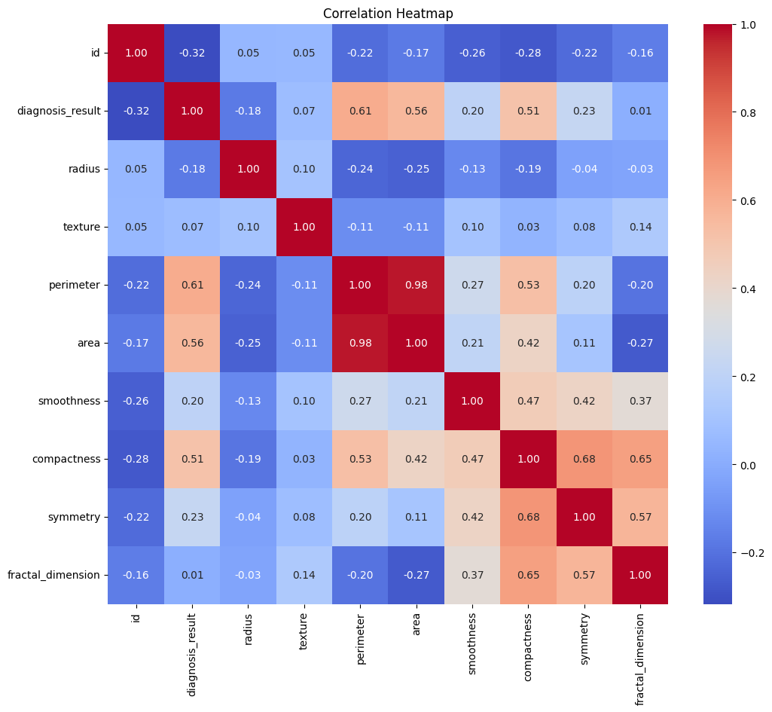
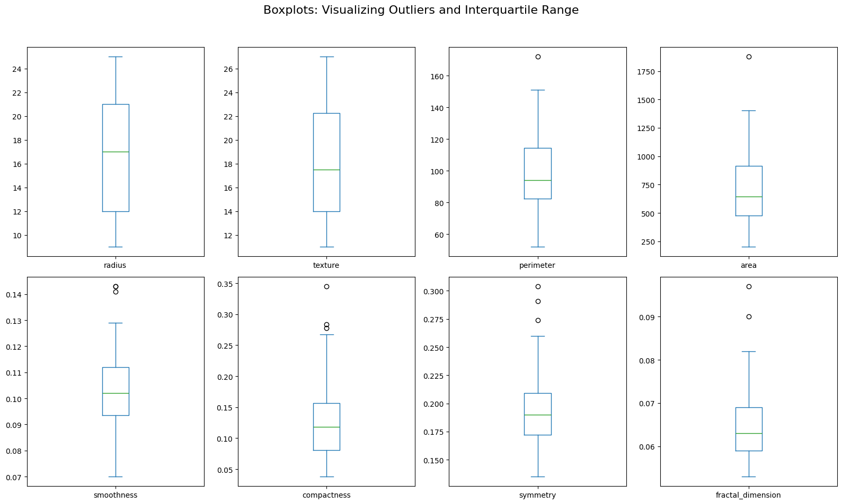
Exploratory Data Analysis (EDA)

Slide 5
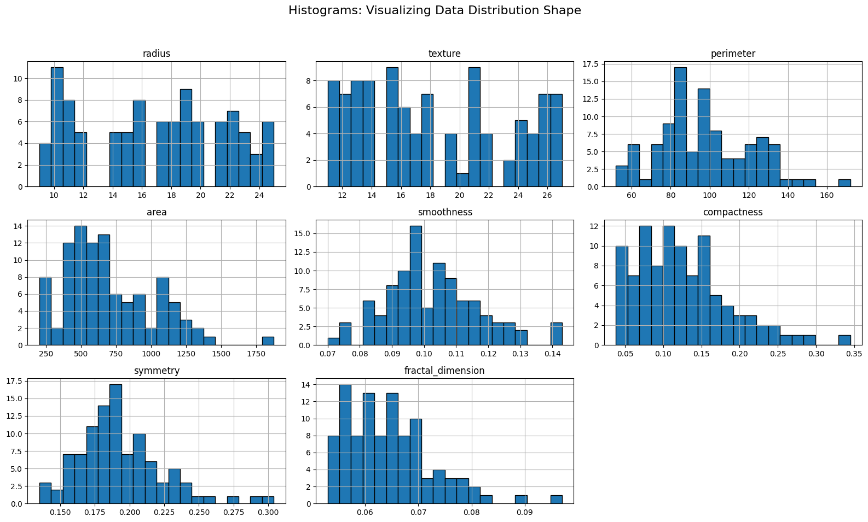

Slide 6
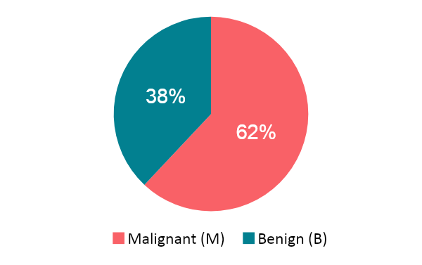
Exploratory Data Analysis (EDA)
Class Distribution
Analysis
Boxplots and histograms revealed right-skewed distributions for some features.
Skewed features identified: area, compactness, fractal_dimension, perimeter
Box plot identified very few outliers in features.
No highly correlated features were present.
No missing values — dataset is clean (100 patients × 10 columns)
Correlation Heatmap Findings
Feature | Importance | Observation
perimeter | 0.61 | Highest feature importance — strong malignancy predictor
area | 0.56 | 2nd most important — highly correlated with diagnosis
compactness | 0.51 | 3rd — correlated with diagnosis
symmetry | 0.23 | Moderate predictive power
smoothness | 0.2 | Lower discriminative value

Slide 7
Data Preprocessing — Two Pipelines
Common Steps (both pipelines)
1. Label Encoding
2. Train/Test Split
3. SMOTE
B=0, M=1 via LabelEncoder
80/20 stratified (random_state=42)
Applied on training fold only to balance classes (34→46 Benign)
Pipeline 1 — Standard
Pipeline 2 — Enhanced
Step 1: SMOTE balancing
Step 2: StandardScaler on all features
Applies uniform scaling across all 8 features. No treatment for skewness.
Step 1: SMOTE balancing
Step 2: Yeo-Johnson transform on skewed features (area, compactness, fractal_dimension, perimeter)
Step 3: StandardScaler on all features
Reduces skewness before scaling → better model performance.
5-Fold Stratified Cross-Validation used in both pipelines

Slide 8
Data Preprocessing — Two Pipelines
1. Standard Scaler
The variance between the mean of the features was quite high; used to normalize and prevent feature dominance.
2. SMOTE
Addresses data imbalance via synthetic generation to prevent model bias toward the majority class.
3. Yeo-Johnson
Transformation applied to remove skewness from highly skewed features for better performance.
Design Rationale
Strategic preprocessing steps implemented to ensure data quality and improve classifier robustness.
The preprocessing reasoning focuses on three core pillars: Feature Scaling, Class Balancing, and Skewness Correction. These combined steps prepare the 100-patient dataset for high-accuracy clinical classification.

Slide 9
Machine Learning Models (6 Classifiers)
Logistic Regression
Linear probabilistic classifier; serves as interpretable baseline.
Params: L2 penalty, C=1, solver=lbfgs
K-Nearest Neighbors
Instance-based learner weighted by neighbour distance.
Params: k=5, weights='distance'
Decision Tree
Tree-based splits using information gain; interpretable.
Params: entropy criterion, max_depth=5
Random Forest
Bagging ensemble of decision trees; robust against overfitting.
Params: 300 estimators, max_depth=5
SVM
Margin-maximising classifier; supports probability output for stacking.
Params: C=0.5, probability=True
Stacking Classifier
Ensemble that learns from predictions of base models via meta-learner.
Params: Base: RF + SVM + DT → Meta: LR (cv=5)

Slide 10
Pipeline 1 Results — SMOTE + StandardScaler
5-Fold Stratified Cross-Validation on full dataset (n=100)
Model | Accuracy | F1 (weighted) | TN | FP | FN | TP
Logistic Regression | 83.0% | 83.2% | 32 | 6 | 11 | 51
KNN | 80.0% | 80.1% | 29 | 9 | 11 | 51
Decision Tree | 77.0% | 76.8% | 25 | 13 | 10 | 52
Random Forest | 82.0% | 82.0% | 29 | 9 | 9 | 53
SVM | 80.0% | 80.1% | 29 | 9 | 11 | 51
Stacking Classifier | 83.0% | 82.9% | 28 | 10 | 7 | 55
Logistic Regression and Stacking Classifier tied for best accuracy (83%).
Stacking shows lower False Negatives (7 FN) — clinically important for missed cancer diagnoses.

Slide 11
Pipeline 2 Results — SMOTE + YeoJohnson + StandardScaler
5-Fold Stratified Cross-Validation on full dataset (n=100)
Model | Accuracy | F1 (weighted) | TN | FP | FN | TP
Logistic Regression | 85.0% | 85.1% | 32 | 6 | 9 | 53
KNN | 79.0% | 79.1% | 29 | 9 | 12 | 50
Decision Tree | 77.0% | 76.9% | 26 | 12 | 11 | 51
Random Forest | 82.0% | 82.0% | 29 | 9 | 9 | 53
SVM | 80.0% | 80.1% | 29 | 9 | 11 | 51
Stacking Classifier | 82.0% | 81.8% | 27 | 11 | 7 | 55
Logistic Regression benefits most from Yeo-Johnson (+2% accuracy). Stacking Classifier maintains lowest FN (7).
YeoJohnson transformation particularly helps models sensitive to feature distribution.

Slide 12
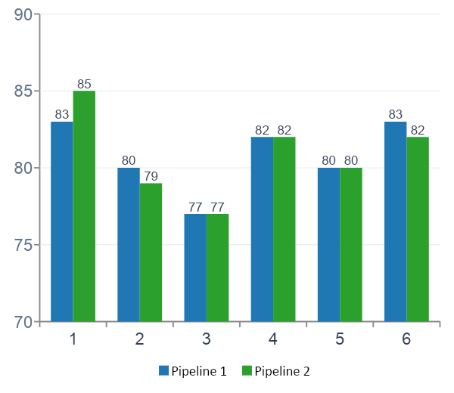
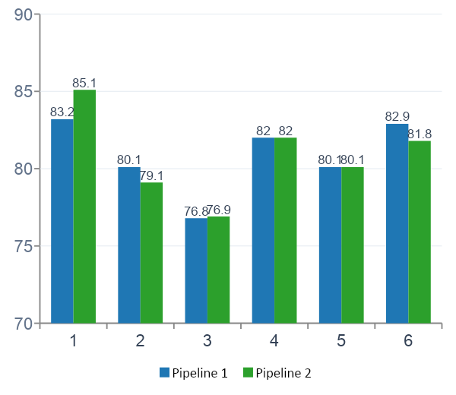
Pipeline 1 vs Pipeline 2 — Comparison
Accuracy Comparison (%)
F1 Score Comparison (%)
Pipeline 2 wins for Logistic Regression (+2%). Other models show similar or equal performance — Yeo-Johnson most benefits distribution-sensitive models.

Slide 13
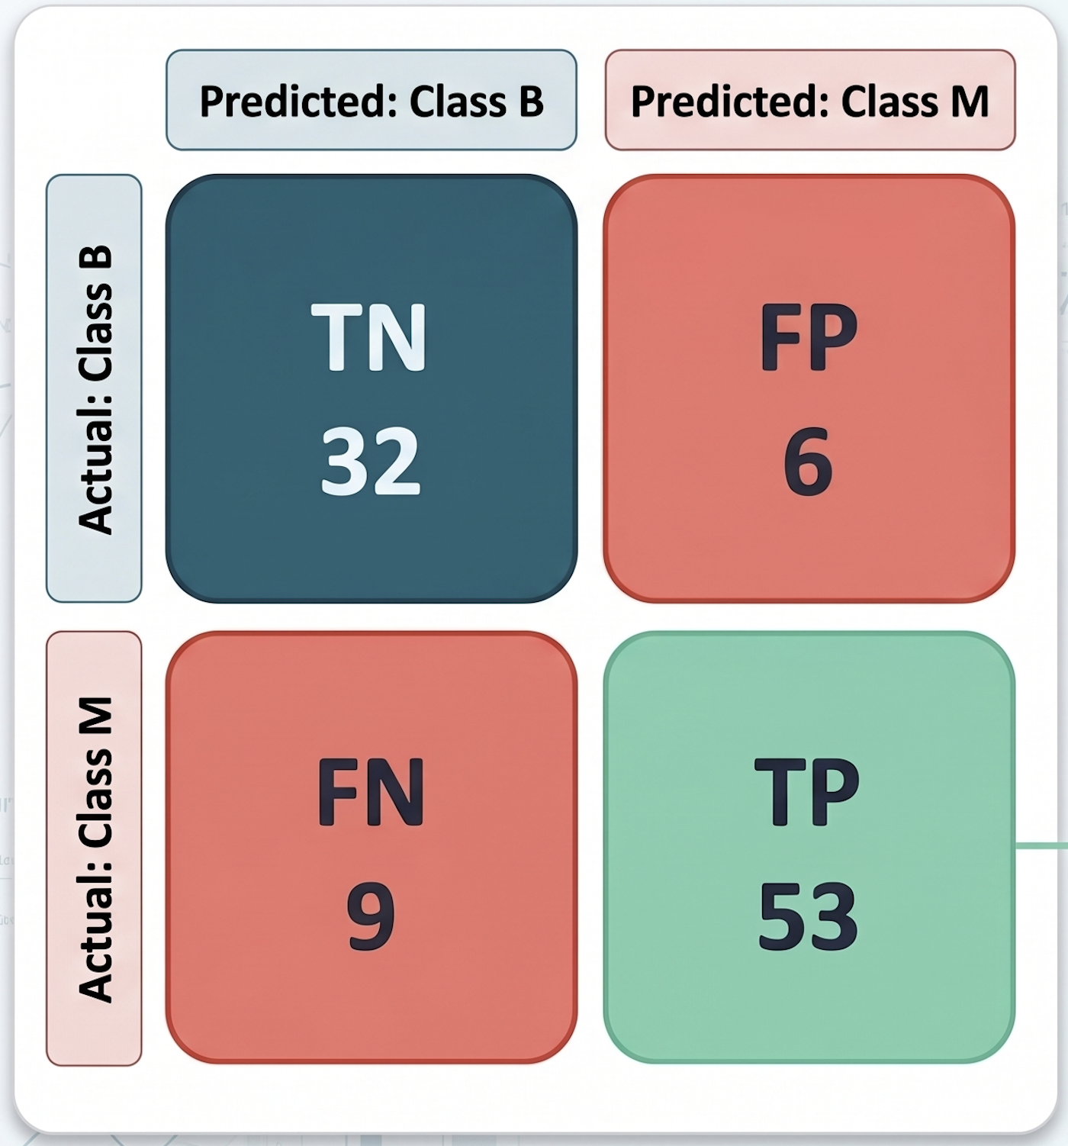
Best Model & Hyperparameter Tuning
Logistic Regression selected as best model (85% acc, 85.1% F1 — Pipeline 2). GridSearchCV used to find optimal hyperparameters.
Search Space
Hyperparameter | Values Tested
penalty | l2, l1
C | 0.1, 1, 10
solver (l2) | lbfgs
solver (l1) | liblinear
Scoring | f1_weighted
CV Folds | 5-Fold Stratified
Class | Precision | Recall | F1
Benign (0) | 0.78 | 0.84 | 0.81
Malignant (1) | 0.90 | 0.85 | 0.88
Accuracy | — | — | 85.0%
F1 Weighted | — | — | 85.1%
Best Params: penalty=l2, C=1, solver=lbfgs

Slide 14
SHAP Analysis — Model Explainability
SHAP (SHapley Additive exPlanations) applied to the best Logistic Regression model from Pipeline 1 using LinearExplainer.
What is SHAP?
Key SHAP Findings
SHAP assigns each feature a contribution value for each individual prediction
Based on game-theory Shapley values — fair attribution among features
LinearExplainer used: efficient for linear models like Logistic Regression
Summary plot shows feature importance AND direction of impact
High SHAP value = pushes prediction toward Malignant (class 1)
Feature | SHAP Insight
texture | Strongest positive driver — high compactness → Malignant
area | High area values push prediction toward Malignant
radius | Positively correlated with Malignant class
symmetry | Low symmetry associated with Malignant tumours
texture / radius | Lower SHAP magnitude — weaker contribution
Why SHAP Matters in Healthcare
In medical diagnosis, a model that cannot be explained is difficult to trust clinically. SHAP bridges the gap between model accuracy and clinical interpretability — allowing physicians to understand which tumour measurements are driving the malignancy prediction.

Slide 15
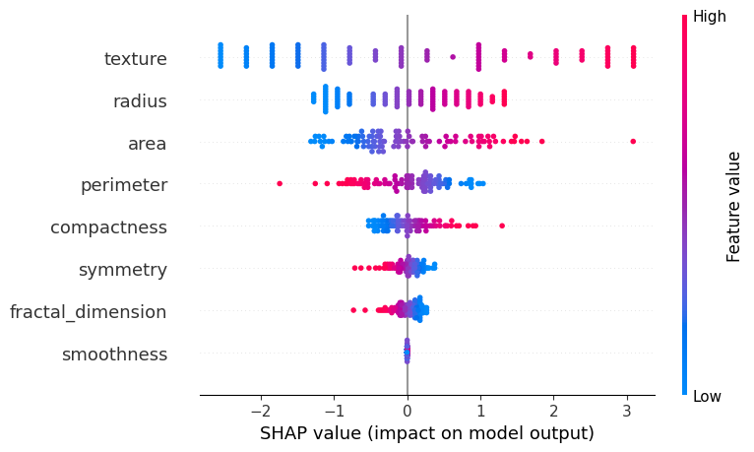
SHAP Analysis — Model Explainability

Slide 16
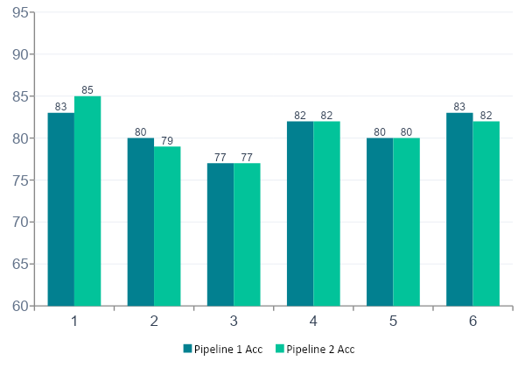
Overall Model Performance Summary
Final Rankings (Best Pipeline)
🥇 1st Log. Regression (P2)
85%
🥈 2nd Stacking (P1)
83%
🥉 3rd Random Forest
82%
4th SVM
80%
5th KNN
80%
6th Decision Tree
77%

Slide 17
Key Findings & Insights
Best Model
Top Features
★
↑
Logistic Regression (Pipeline 2) achieved 85% accuracy & 85.1% F1 — best across all 6 classifiers.
Area (24.9%), Compactness (22.6%), Perimeter (20%) together account for ~68% of feature importance.
Pipeline 2 Wins
Stacking Advantage
⚡
♟
Yeo-Johnson transform on skewed features improved Logistic Regression by +2% — confirms skewness correction matters.
Stacking Classifier had fewest False Negatives (7 FN) — clinically most valuable for minimising missed cancer cases.
SHAP Explainability
Decision Tree Limit
✓
⚠
SHAP confirmed compactness and area as top malignancy drivers — aligns with Random Forest feature importance.
Decision Tree scored lowest (77%) — even at max_depth=5, limited generalisation on this small dataset.

Slide 18
Conclusion & Future Work
Conclusions
Logistic Regression + Pipeline 2 (YeoJohnson) is the best model at 85% accuracy
6 classifiers tested; all achieved >77% — dataset is learnable
Pipeline 2 (with Yeo-Johnson) outperforms Pipeline 1 for distribution-sensitive models
Stacking Classifier minimises False Negatives — most clinically safe choice
SHAP confirms compactness, area, and perimeter as dominant malignancy indicators
Preprocessing quality (handling skewness) meaningfully impacts results
Future Work
Apply deep learning (MLP) on a larger prostate cancer dataset
Explore additional ensemble strategies (boosting: XGBoost, LightGBM)
Extend SHAP analysis to all models for comprehensive interpretability
Perform feature selection to address multicollinearity between area/perimeter/radius

